Slide 1
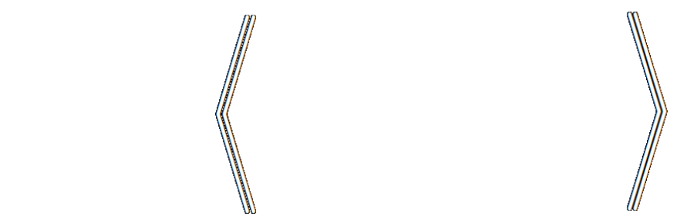

Probabilistic (In)consistency as a Basis for Learning and Inference: Choose your Model, not your Loss Function
Oliver Richardson

Slide 2
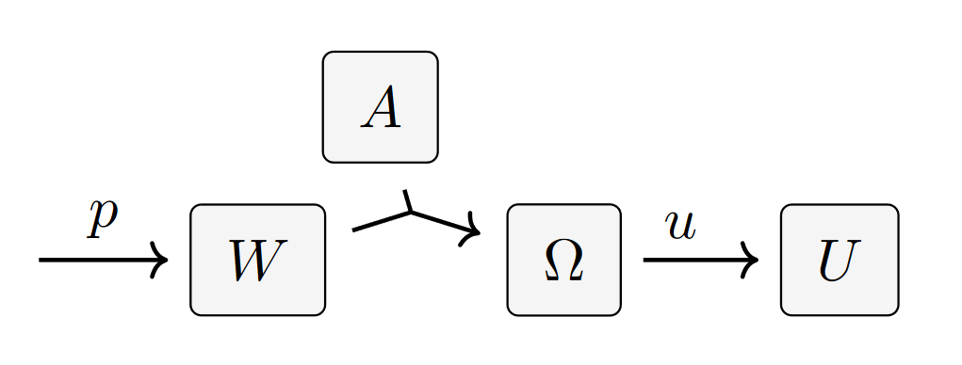
The usual picture of an agent
Such an agent cannot have conflicted beliefs (or preferences)
… and where do utilities come from?

Slide 3
How To Choose A Loss Function?
Casting AI as optimization is useful … but what to optimize?
{ Cross Entropy, Square Error, +Regularizers, … ?}
A choice of loss is a preference, by honed instinct, tradition, pragmatics.
But a choice of model admits more principled discussion:
models can be validated; make claims about reality.

Slide 4
Probabilistic Dependency Graphs (PDGs)
/pʌdgàhz/
variables connected by conditional probabilities
& independent causal mechanisms

Slide 5
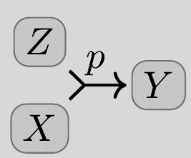
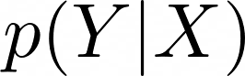
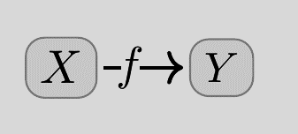
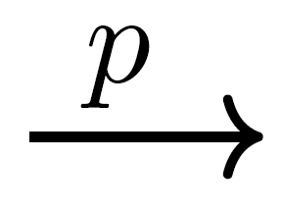
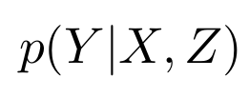
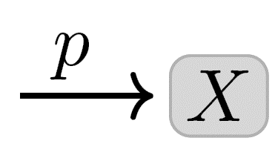
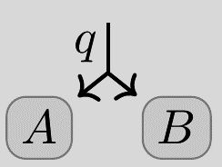
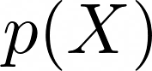
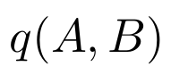
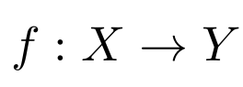
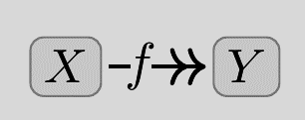
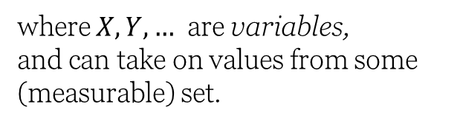
Conditional Probability Distributions (CPDs)
(and how to draw their shapes)
(Deterministic functions)
where $X,Y,…$ are variables,
and can take on values from some (measurable) set.

Slide 6
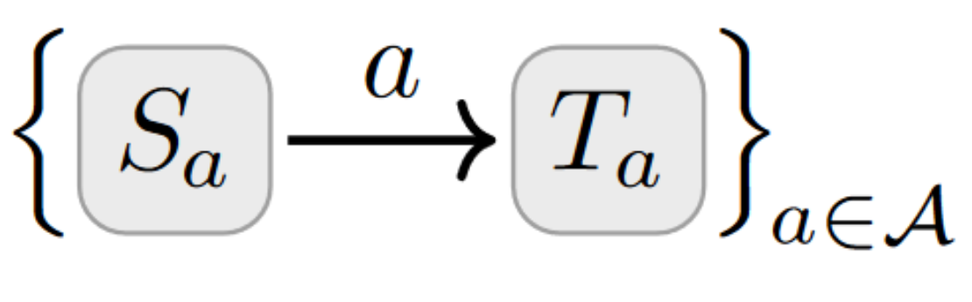
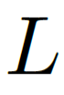
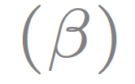
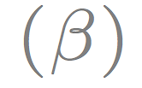
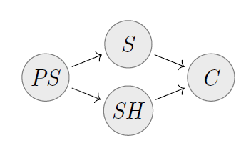
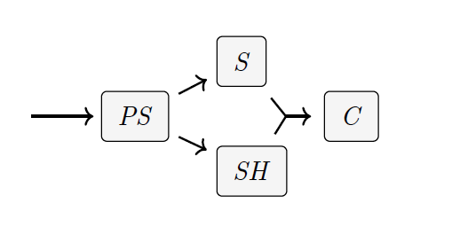
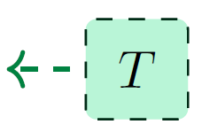
Probabilistic Dependency Graphs (PDGs)
a very general class of graphical models including Bayesian Networks and Factor Graphs
weighted by confidence
weighted by confidence
In brief: a collection of cpds
β = 0 “no confidence”
β = ∞ “absolute confidence”
β = 1 default
BN
PDG
can model inconsistent information, and can measure the degree of inconsistency.

Slide 7
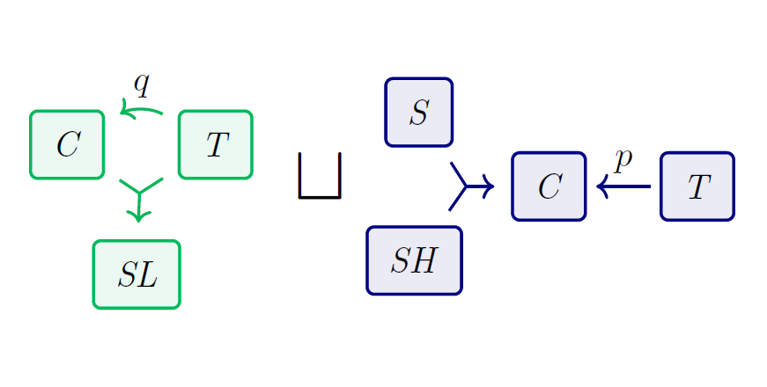
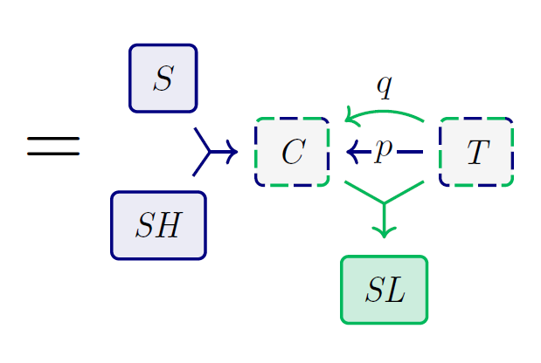
+
Combine independent PDGs by taking disjoint union of arcs, union of variables

Slide 8
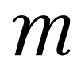
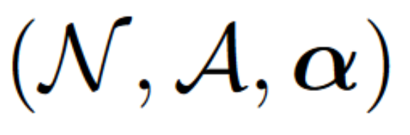
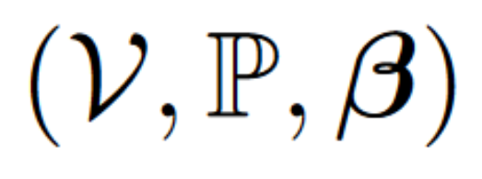
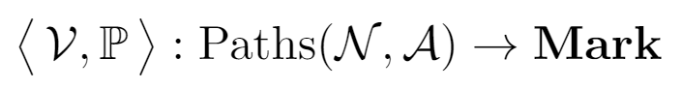
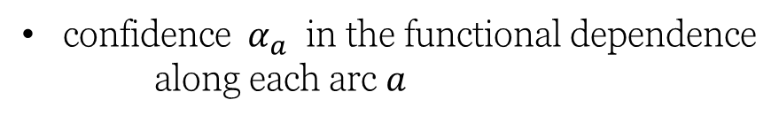
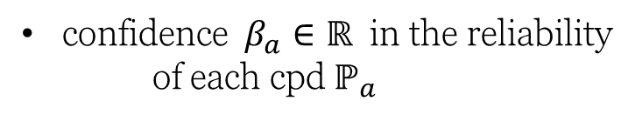
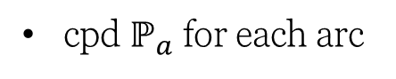
PDG Definition
Qualitative Info
Quantitative Info
set of nodes
set of values for each node
set of directed (hyper)arcs
cpd $ℙ_{a}$ for each arc
confidence $α_{a}$ in the functional dependence along each arc $a$
confidence $β_{a}∈ℝ$ in the reliability of each cpd $ℙ_{a}$
Weighted Directed Hypergraph
Functor

Slide 9
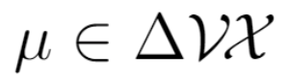

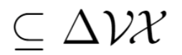
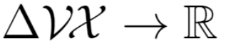
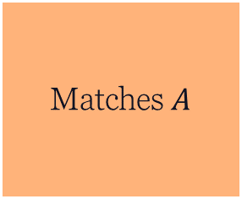
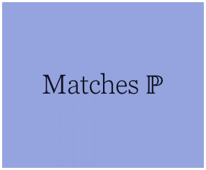
PDG Semantics
Joint probability distribution over all variables
Set of probability distributions that have all conditional probabilities
A function that scores probability distributions by compatibility
The (often unique) distribution(s) that have the best score.
Matches $ℙ$
Matches $A$

Slide 10
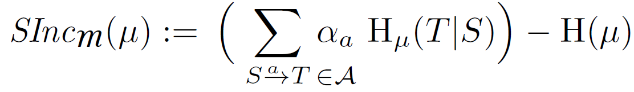
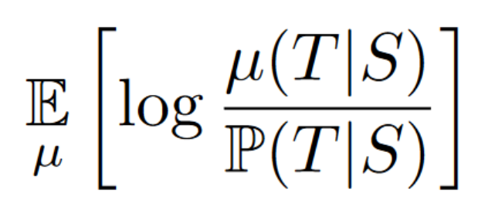
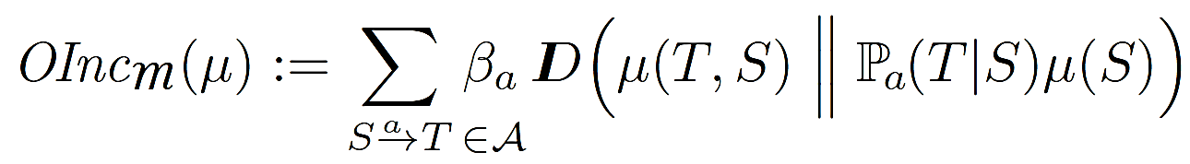
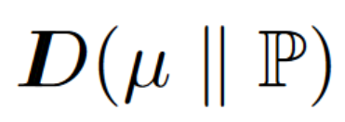
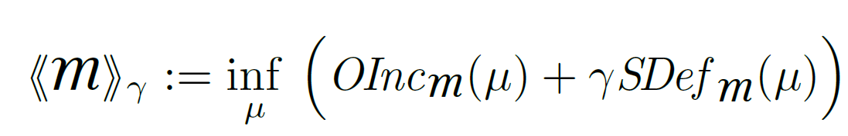
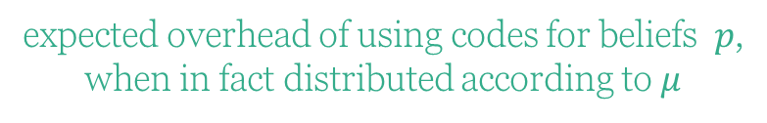
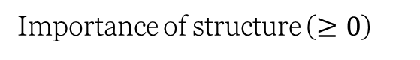
Scoring Function Semantics
Observational Incompatibility (OInc)
Structural Deficiency (SDef)
expected overhead of using codes for beliefs $p$,
when in fact distributed according to $μ$
# bits needed to determine all vars together
# bits needed to separately determine each T from S
(scaled by confidence)
(not the focus of this talk)
Inconsistency of a PDG := the smallest possible incompatibility with any $μ$
Importance of structure ($≥0$)

Slide 11
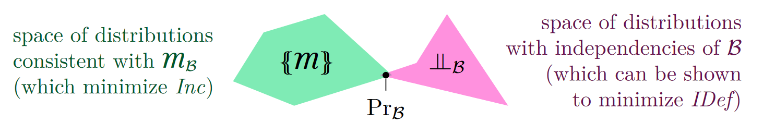
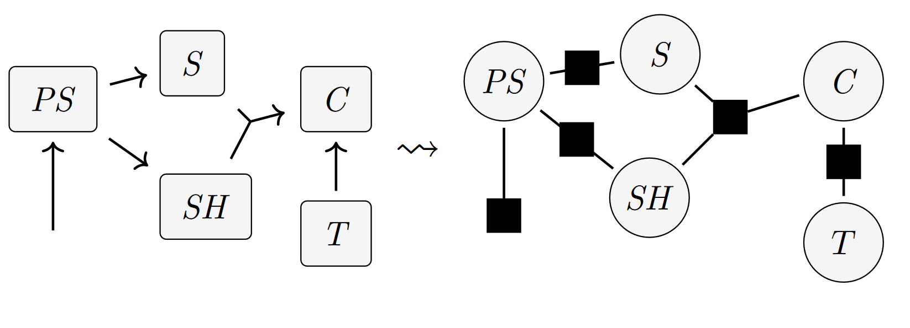
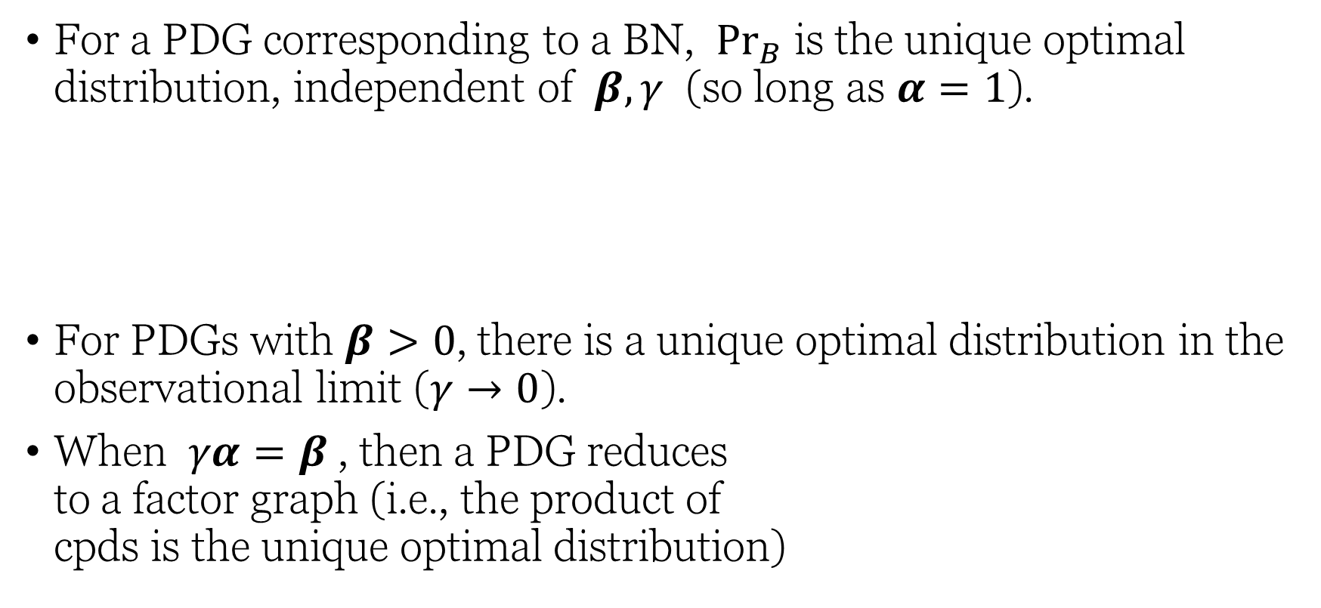
Some Theorems
For a PDG corresponding to a BN, ${Pr}_{B}$ is the unique optimal distribution, independent of $β, γ$ (so long as $α=1$).
For PDGs with $β>0$, there is a unique optimal distribution in the observational limit ($γ→0$).
When $γα=β$, then a PDG reduces to a factor graph (i.e., the product of cpds is the unique optimal distribution)
(Can be shown to minimize SDef)
(which minimize OInc)

Slide 12
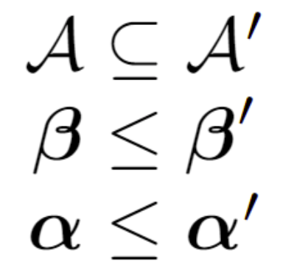
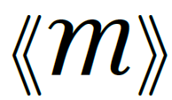
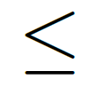
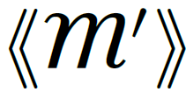
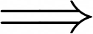
Key Fact: Monotonicity of Inconsistency
Believing more things cannot make you any less inconsistent.

Slide 13
Minimizing (PDG) Inconsistency is a universal objective.

Slide 14







The important building blocks of ML systems are conditional probabilities…
statistical models
(e.g., neural networks)
datasets
constraints
priors

Slide 15


How To Choose A Loss Function?
One Answer: model all relevant information with a PDG, and measure how inconsistent it is.
Surprising Fact: Standard loss functions can be viewed as measuring the degree of inconsistency of the PDG describing the situation.
Bonus: A visual calculus for reasoning about the relationships between loss functions
data
priors
predictor

Slide 16
INFORMATION-BASED LOSSES as Inconsistencies

Slide 17



Information Content / Surprisal / NLL as Inconsistency
the standard measure of discrepancy between probability $p(X)$ and outcome $X=x$

Slide 18






Variants of Information Content as Inconsistencies
Marginal Information
for partial observations
Conditional Information
for conditional models
Average Information
Works for whole dataset at once
--- if high confidence in data
constant in $p$;
irrelevant

Slide 19







A Map
Full-Dataset
Unsupervised
+ multi-sample
+latent variables
Exact Models
+ conditional model
Latent Variable Models
Single- Observation
Supervised

Slide 20
OTHER STANDARD METRICS as Inconsistencies
Accuracy
Mean-Squared Error (MSE)

Slide 21





(Log) Accuracy as Inconsistency
hypothesis
true labels

Slide 22





Mean Square Error as Inconsistency
where
is a unit Gaussian on Y with mean $μ$

Slide 23
REGULARIZERS as Inconsistencies

Slide 24













Regularizers $↔$ Priors
Terms added to loss functions to incentivize “simple models”
Distributions over
model parameters
parameterized model
trusted empirical distribution
parameter setting
prior over parameters
$$↔$$
regularizer

Slide 25


Regularizers $↔$ Priors
parameterized model
trusted empirical distribution
parameter setting
Terms added to loss functions to incentivize “simple models”
Distributions over
model parameters
prior over parameters
For example, using a (discretized) Gaussian as a prior
, we get

Slide 26
STATISTICAL DIVERGENCES as Inconsistencies

Slide 27




Statistical Divergence as Inconsistency
You believe both $p(X)$ and $q(X)$.
Your inconsistency: a divergence between $p$ and $q$?

Slide 28



Map of as $(r,s)$ vary

Slide 29

By Monotonicity …
Twice Bhattacharya Distance is no larger than forward or reverse KL.
Rényi Entropy is Monotonic in $α$.

Slide 30

Visual Proof: Data-Processing Inequality
p
f
f(p)
f
f(q)
q

Slide 31


Visual Proof: Data-Processing Inequality
Monotonicity

Slide 32
VARIATIONAL OBJECTIVES as Inconsistencies

Slide 33










Variational Auto Encoders (VAEs), Take 1.
Loss Function: Negative ELBO(x)
= reconstruction error + divergence from prior $p(Z)$
Variational Justification:
might suffice to maximize this?
want to maximize
“evidence” of x
VAEs are Not Graphical Models:
e(Z|X) and p(Z) are both distributions over Z; can’t have both.
The heart of a VAE is not the architecture, but the loss function

Slide 34





VAEs, Take 2
Structure:
encoder $e(Z|X)$
decoder $d(X|Z)$
prior $p\left(Z\right)$
observe a sample $x$
loss function is free:
β-VAE
Objective

Slide 35

Visual Proof: The ELBO
Monotonicity (believing more cannot make you less inconsistent)

Slide 36


Inference for PDGs (as probabilistic models)
Given PDG $\text{M}$, structural importance $γ>0$,
compute $μ^{∗}\left(Y=y \right| X=y)$
where $μ^{∗}$ maximizes ${\text{⟦} \text{M} \text{⟧}}_{γ}$

Slide 37















Theorem: Polynomial Time PDG Inference
under bounded treewidth
For $γ∈\{0^{+}\}∪\left(0, \min_{a∈𝒜}\frac{β_{a}}{α_{a}} \right]$, can
do $γ$-inference and
calculate $γ$-inconsistency
for a PDG that has
N arcs and vars, treewidth T,
$0^{+}$ semantics
(limit as $γ→0$)
$$β$$
and gap $β^{max}$ / $β^{min}$ between the largest
and smallest confidences,
to precision $ε$, in time
factor graphs
($α,β,γ=1$)
confidence in observation
Bayesian networks (acyclic, $α=1$)
factored exponential families ($γα=β$)
$$≈$$
$$±γ$$
$$\text{confidence} \text{in} \text{structure}$$
$$γα$$

Slide 38


Empirical Results
Implementation
connects PDG python library to commercial solvers such as MOSEK and ECOS, via cvxpy.
http://github.com/orichardson/pdg

Slide 39
The Local Inconsistency Resolution (LIR) Algorithm

Slide 40
Learning
Inference
Model
Query
Data
Model
Model
Response
(update model to make it more consistent with data)
(update query to make it more consistent with model)

Slide 41



Changing parameters = training
Changing label = inference
Changing input = adversarial attack

Slide 42


Slide 43





1.
Select attn and ctrl masks
Gradient Flow of $f:Θ→ℝ$ starting at $θ$:
Calculate the inconsistency of the combined context and memory,
weighted by attention.
2.
Reduce this inconsistency by (an approximation to) gradient flow,
starting at previous state $θ^{\left(t\right)}$,
changing each parameter in proportion to our control of it.

Slide 44

To Summarize, PDGs…
can model inconsistency, including conflicting information
are especially modular
cleanly separate quantitative from qualitative information, and can express variable confidence in each ($β$ and $α$)
capture standard graphical models (BNs & FGs)
capture standard loss functions, and are a visual language for reasoning about them
paint a unifying picture of many ML algorithms in terms of inconsistency resolution
provide a foundation for a different kind of agent: one driven by pursuit of coherence, not (necessarily) maximization

Slide 45
EXTRA

Slide 46
A NON-STANDARD SETTING “Do PDGs ever prescribe a loss that’s not what you’d first think of?”

Slide 47





Want to predict Y from X,
and have access to both simulated and real data.
What loss to use?
Simulator & data don’t interact!
Uncalibrated!
Geometric mean of
s and d

Slide 48



Hypergraphs vs Graphs

Slide 49




Training Generative Adversarial Networks (GANs). Typically trained with minimax game: $\min_{G}{\max_{D}{ℒ^{GAN}}}$
Generator’s focus
Discriminator’s focus
inconsistency = JSD$( G, p_{data})$
or +$ℒ^{GAN}$ if disbelieves D
inconsistency = KL($D, D^{opt})$
or - $ℒ^{GAN}$ if disbelieves e

Slide 50





From Factor Graphs to PDGs

